Slide 1
SREDNJA ŠKOLA AMBROZA HARAČIĆA MALI LOŠINJ
STRUČNO VIJEĆE POMORSKI NAUTIČAR
Kap.Renato Dudić,prof.
Route Planning – Planiranje rute
Navigacijski Simulator NTPRO 6

Slide 2
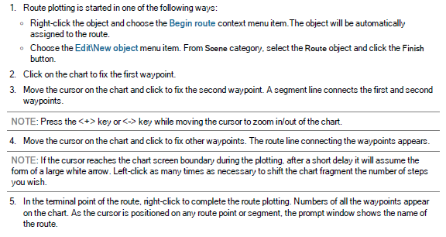
Plotting Route on Chart

Slide 4
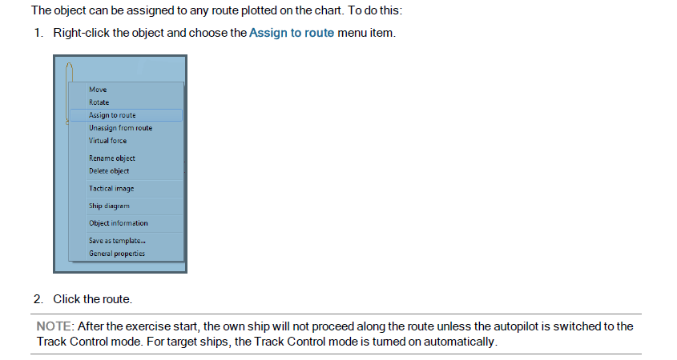
Assigning Object to Route

Slide 5
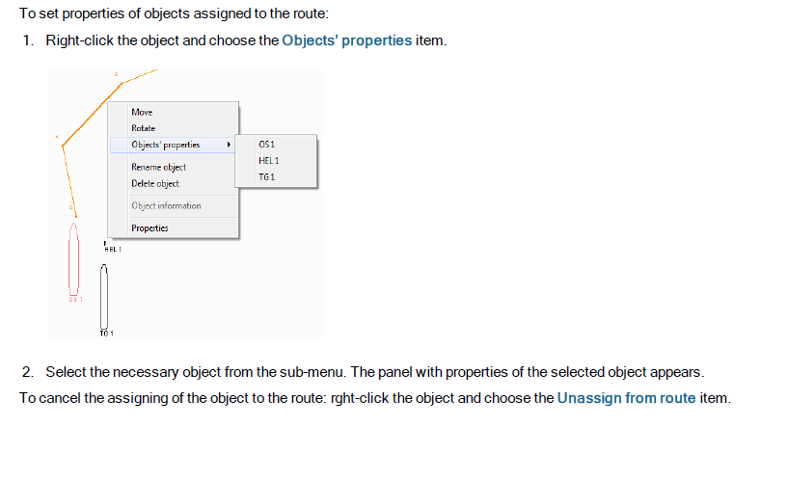

Slide 6
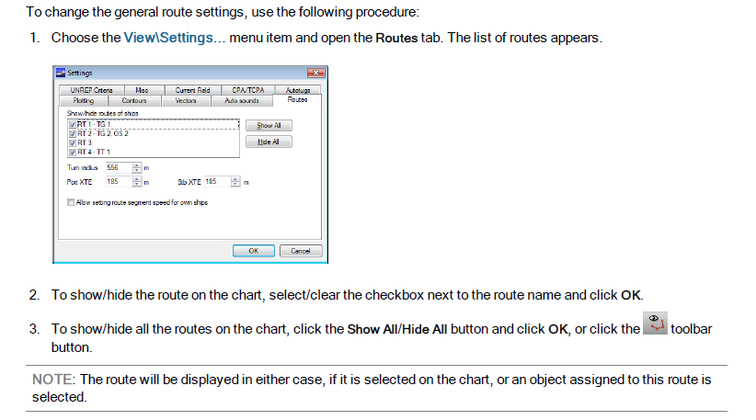
General Route Settings

Slide 8
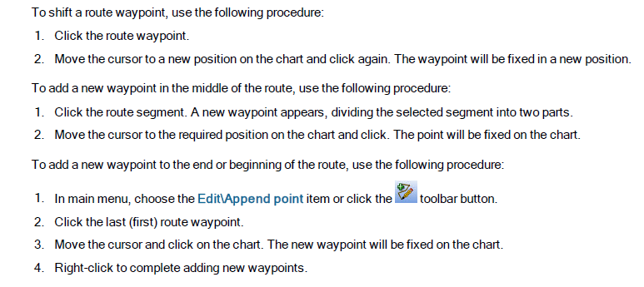

Slide 9
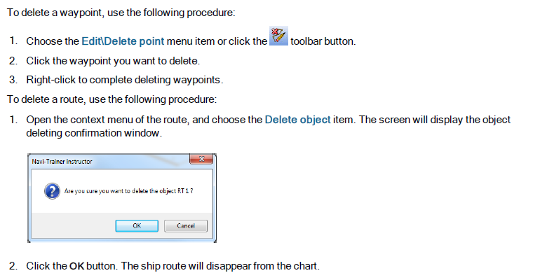
Editing Route on Chart

Slide 10
Setting Route Properties

Slide 11
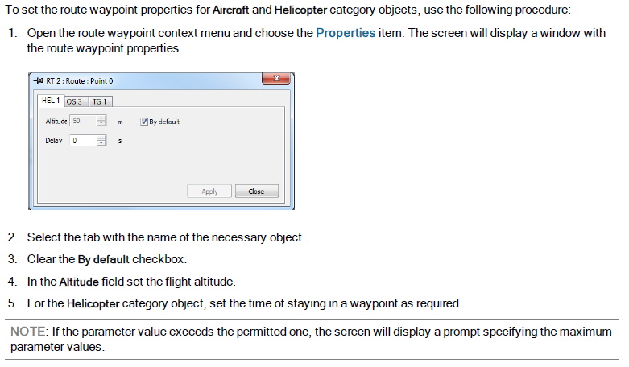
Setting Route Waypoint Properties

Slide 12
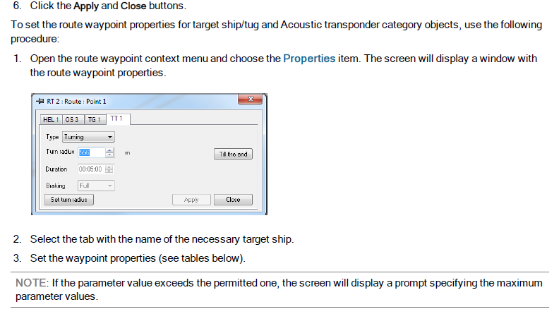

Slide 15
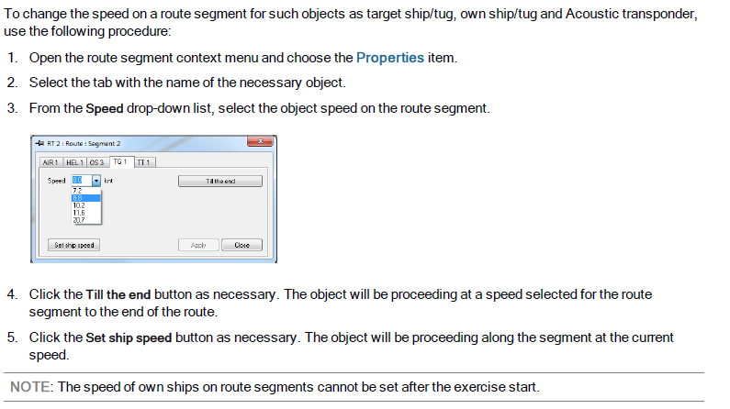
Setting Route Segment Properties

Slide 17
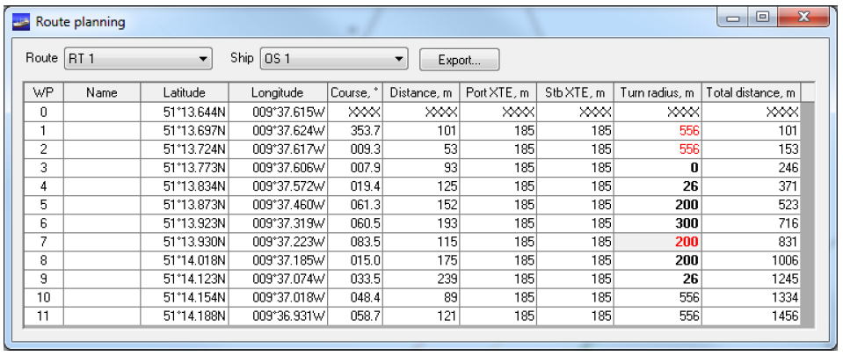
Route Tabular Form

Slide 18
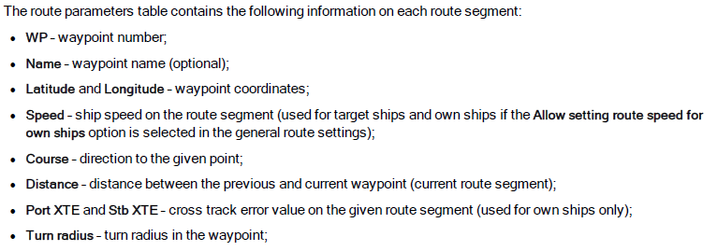

Slide 19
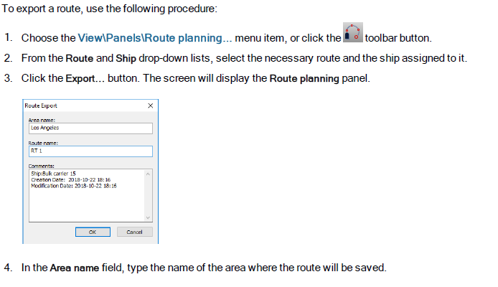
Route Export and Import

Slide 20
